Slide 1
Informed Search Strategies

Slide 2
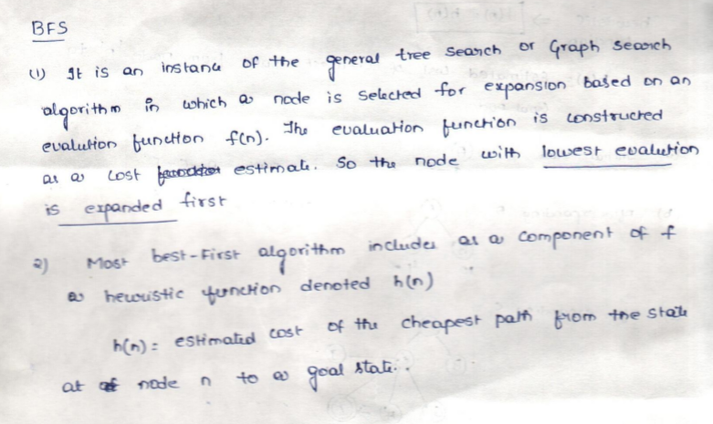
Best First Search(BFS)

Slide 3
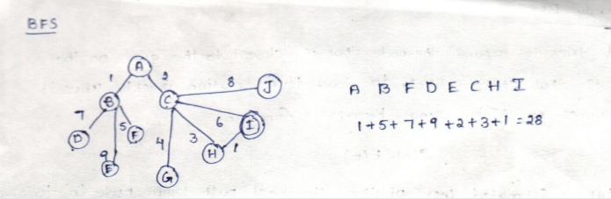

Slide 4
1.13 Heuristic(Informed) Search Techniques
Heuristic is a method that involves an adapting approach to a problem based on previous solutions to similar problems.
Informed search strategy—one that uses problem-specific hints about the location of the goals.
The hints come in the form of Heuristic function denoted by h(n).
where h(n) is the estimated cost of the cheapest path from node n to goal state.
It is a criterion for determining which among several alternatives will be the most effective to achieve some goal.
The principle of a heuristic can be applied to various problems in mathematics, science and optimization by applying heuristics computationally.
It can find solutions more efficiently than can an uninformed strategy.

Slide 5
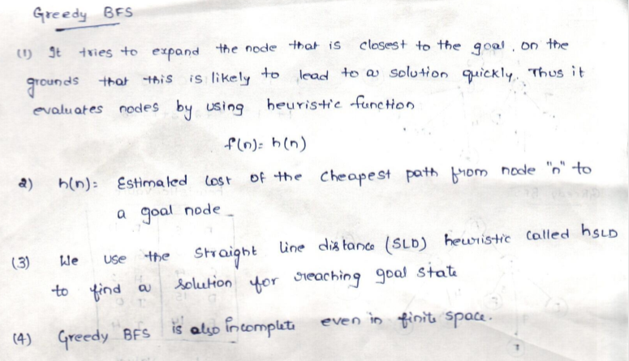
Greedy Best First Search

Slide 6
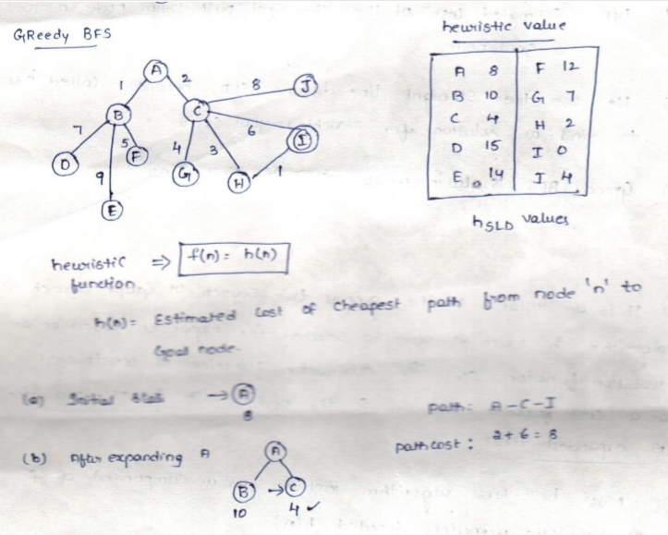
Example-1

Slide 7
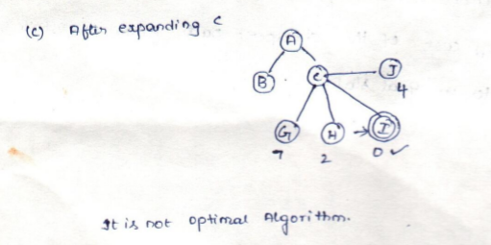

Slide 8
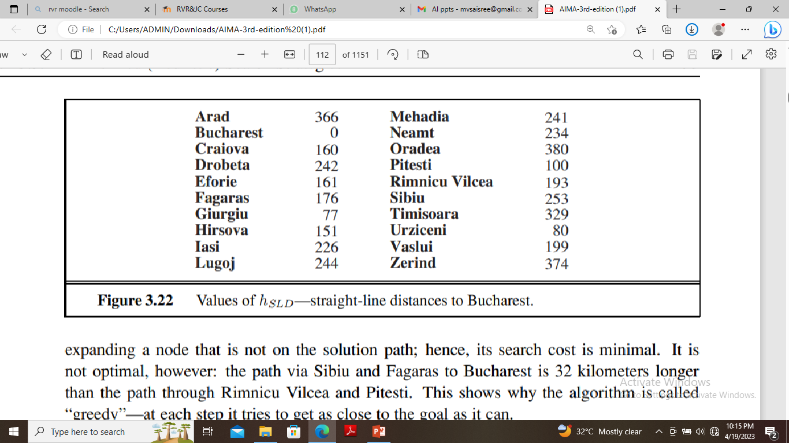
Greedy best first search-Example-2
Greedy best-first search tries to expand the node with lowest h(n) value.-the node that appears to be closest to the goal.
Thus, it evaluates nodes by using heuristic function, f(n) = h(n).
Consider route-finding problem in Romania; we use the straight-line distance heuristic, which we will call hSLD .
If the goal is Bucharest, we need to know STRAIGHT-LINE DISTANCES to Bucharest. For example, hSLD (In(Arad)) = 366.

Slide 9
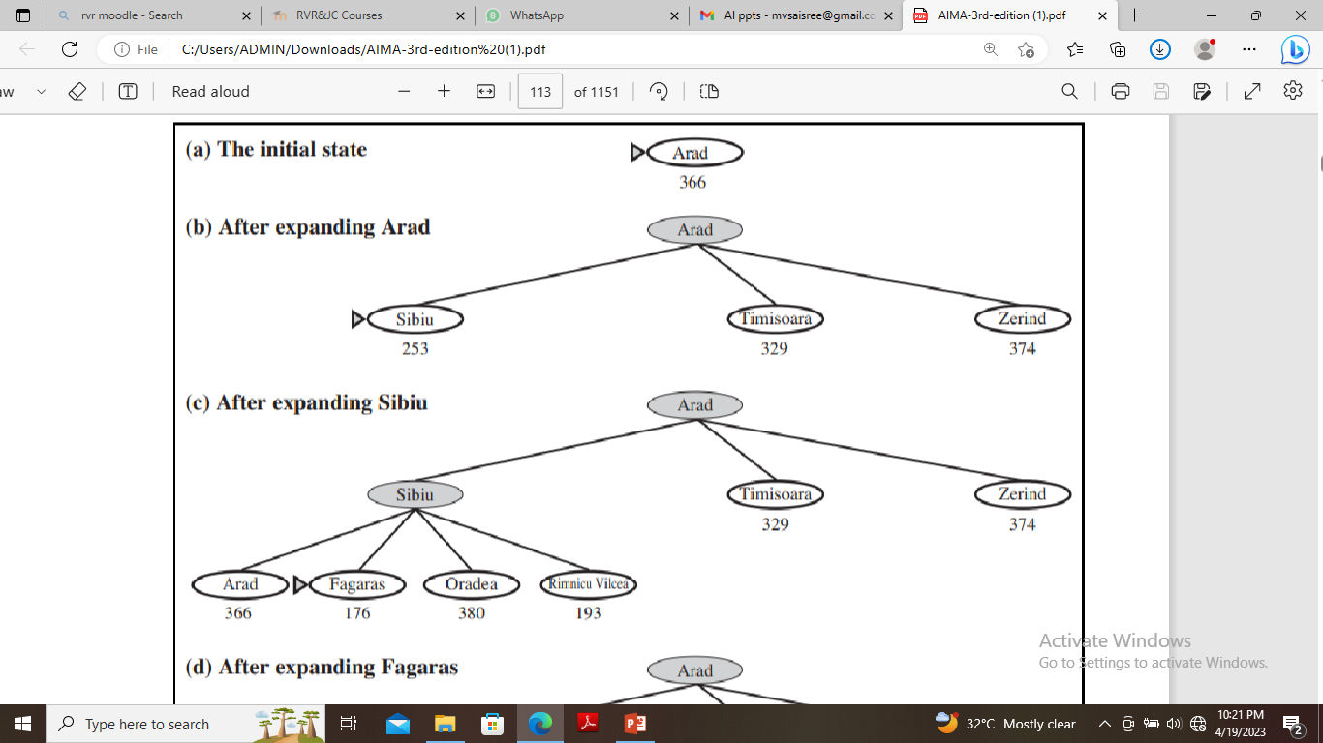

Slide 10
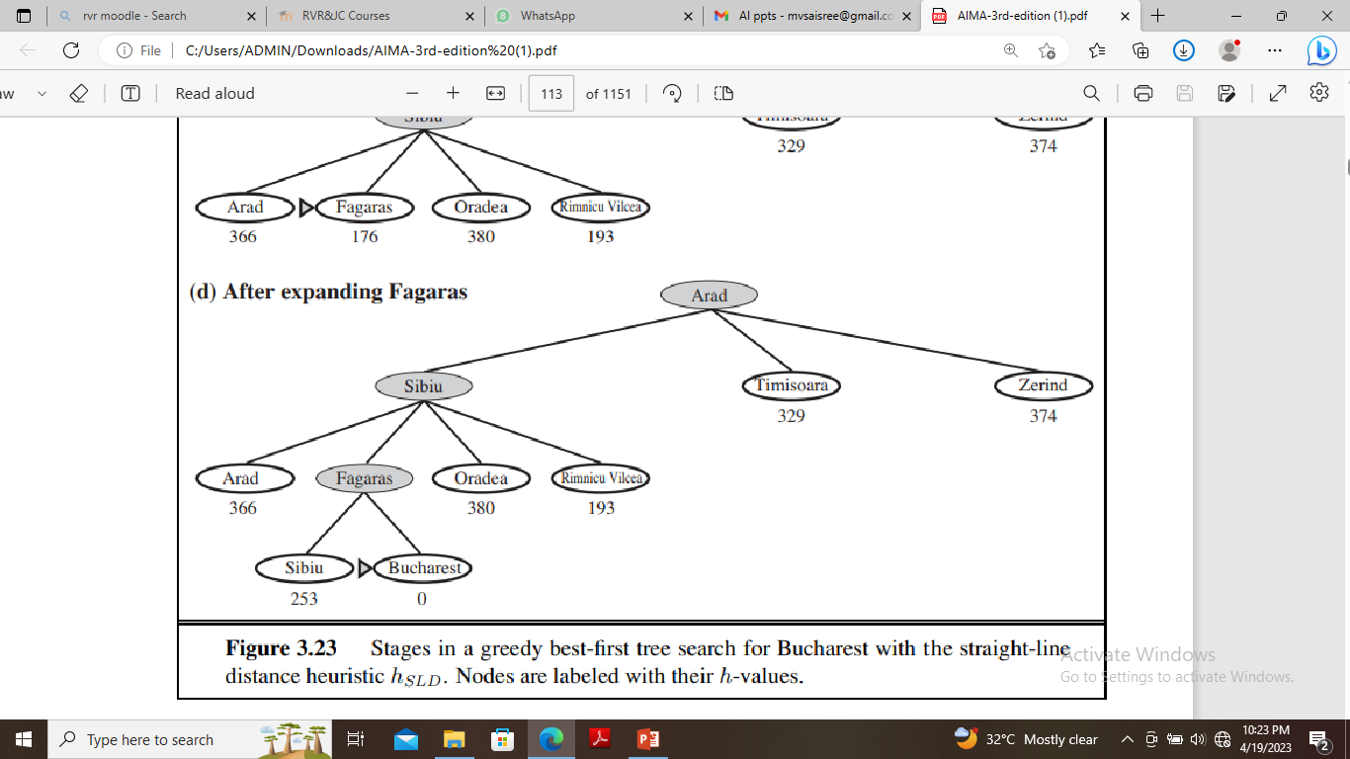

Slide 11
A * Algorithm
The most widely known form of best-first search is called A∗ search .
It uses the evaluation function f(n) = g(n) + h(n) . ,
where g(n) gives the path cost from the start node to node n, and
h(n) is the estimated cost of the cheapest path from n to the goal,
f(n) is estimated cost of the cheapest solution through n .
Thus, if we are trying to find the cheapest solution, then try to expand the node with the lowest value of g(n) + h(n).
The algorithm is identical to UNIFORM-COST-SEARCH except that A∗ uses g + h instead of g.

Slide 12
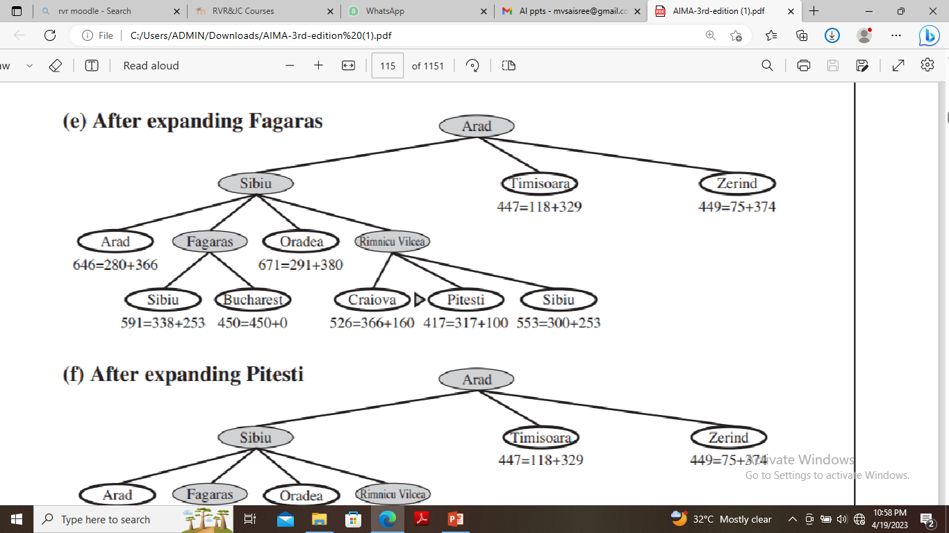
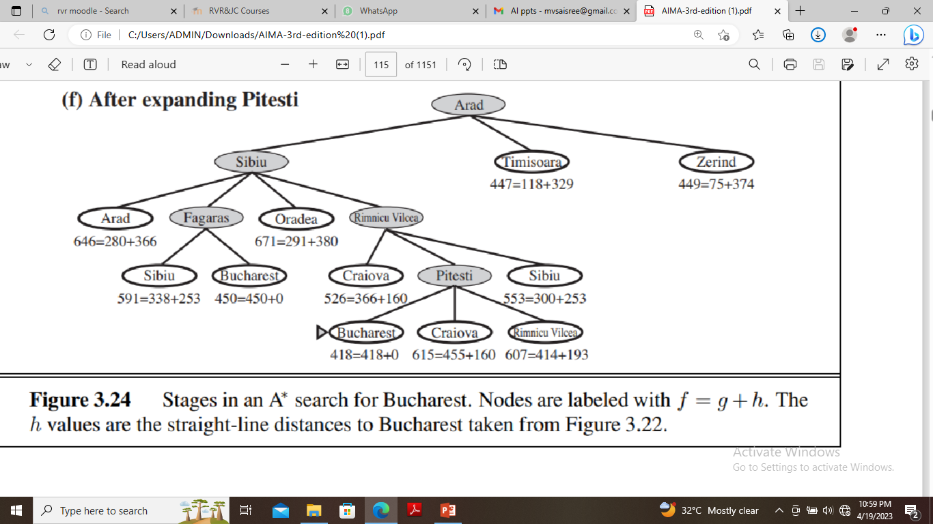
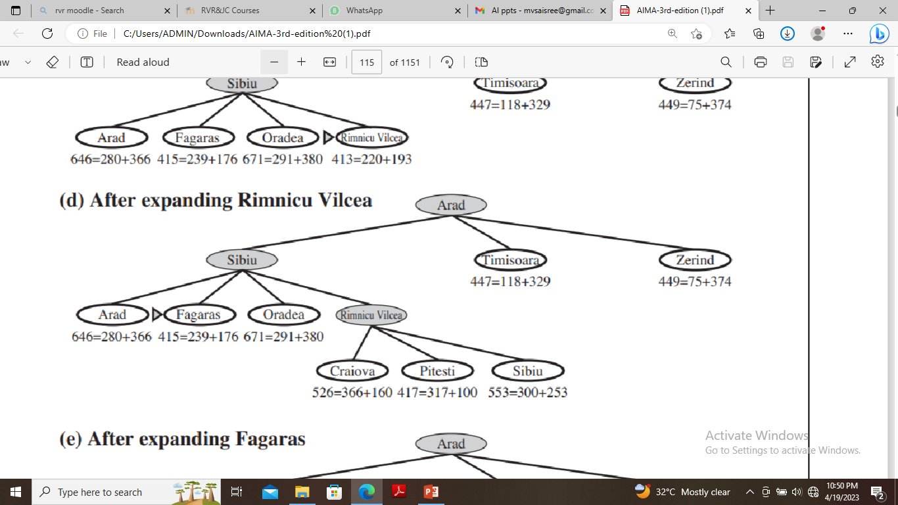
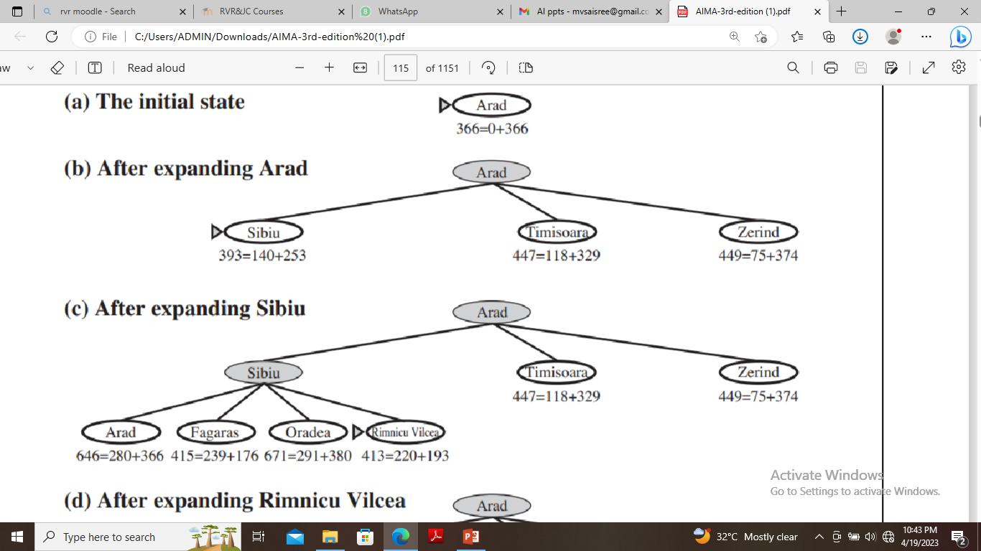

Slide 13
A* algorithm is called OR graph / tree search algorithm.
A* algorithm incrementally searches all the routes starting from the start node until it finds the shortest path to a goal.
Starting with a given node, the algorithm expands the node with the lowest f(X) value.
It maintains a set of partial solutions.
Unexpanded leaf nodes of expanded nodes are stored in a queue with corresponding f values. This queue can be maintained as a priority queue.

Slide 14
Conditions for optimality
The first condition we require for optimality is that h(n) be an admissible heuristic.
An admissible heuristic is one that never overestimates the cost to reach the goal.
Second condition is consistency (or sometimes monotonicity) MONOTONICITY is required only for applications of A∗ to graph search.
A heuristic h(n) is consistent if, for every node n and every successor n’ of n generated by any action a, the estimated cost of reaching the goal from n is no greater than the step cost of getting to n’ plus the estimated cost of reaching the goal from n’ : h(n) ≤ c(n, a, n’) + h(n’ ) .
This is a form of the general triangle inequality, which stipulates that each side of a triangle cannot be longer than the sum of the other two sides.

Slide 15
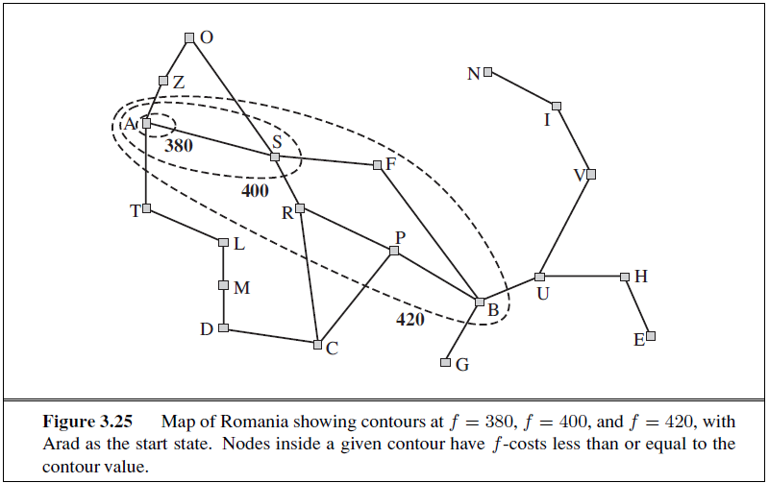
Search Contours
f-costs are non-decreasing along any path also means that we can draw contours in the state space, just like the contours CONTOUR in a topographic map.
We can also form contours in Uniform cost search also but with g not with h+g. g costs are monotonic , the path cost always increases as we go along the path because g costs are always positive.
Inside the contour labeled 400, all nodes have f(n) less than or equal to 400,and so on.

Slide 16
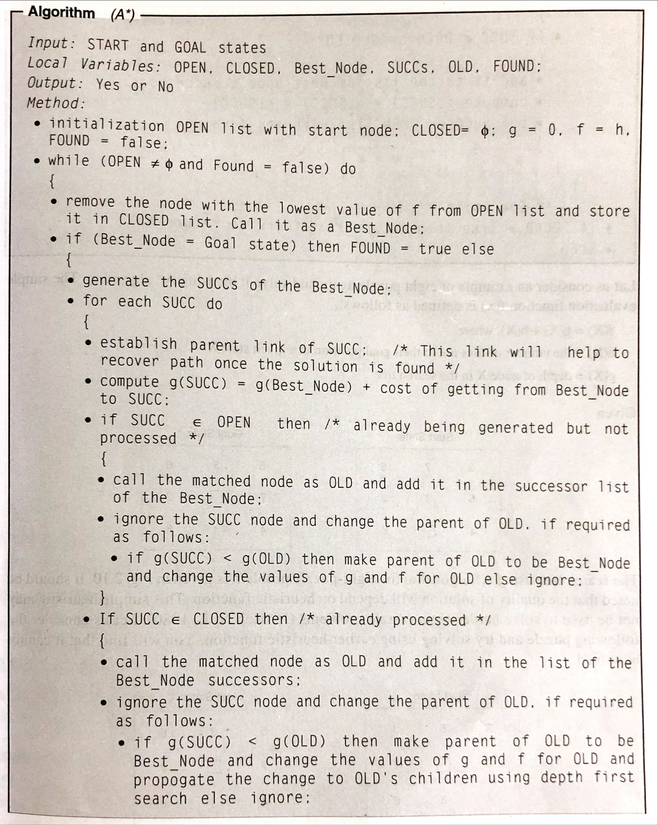

Slide 17
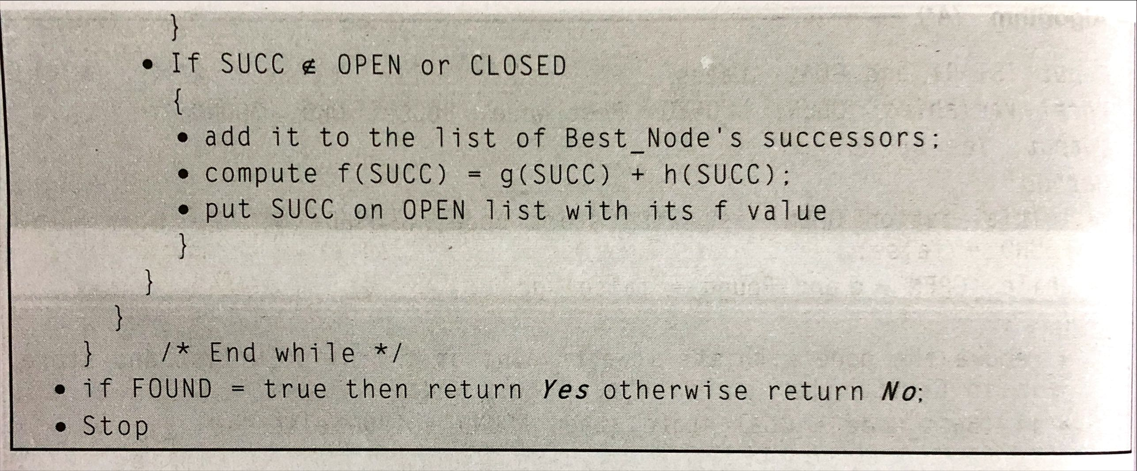

Slide 18
Memory-bounded heuristic search
The simplest way to reduce memory requirements for A∗ is to adapt the idea of iterative deepening to the heuristic search context, resulting in the Iterative-Deepening A∗ (IDA∗) algorithm.
The main difference between IDA∗ and standard iterative deepening is that the cutoff used is the f-cost (g+h) rather than the depth.
At each iteration, the cutoff value is the smallest f-cost of any node that exceeded the cutoff on the previous iteration.
IDA∗ is practical for many problems with unit step costs and avoids the substantial overhead associated with keeping a sorted queue of nodes.
Unfortunately, it suffers from the same difficulties with real valued costs.
There are two other memory-bounded algorithms, called RBFS and MA.

Slide 19
Recursive best-first search (RBFS)
Its structure is similar to that of a recursive depth-first search, but rather than continuing indefinitely down the current path, it uses the f limit variable to keep track of the f-value of the best alternative path available from any ancestor of the current node.
If the current node exceeds this limit, the recursion unwinds back to the alternative path.
As the recursion unwinds, RBFS replaces the f-value of each node along the path with a backed-up value—the best f-value of its children.
In this way, RBFS remembers the f-value of the best leaf in the forgotten subtree and can therefore decide whether it’s worth re-expanding the subtree at some later time.

Slide 20
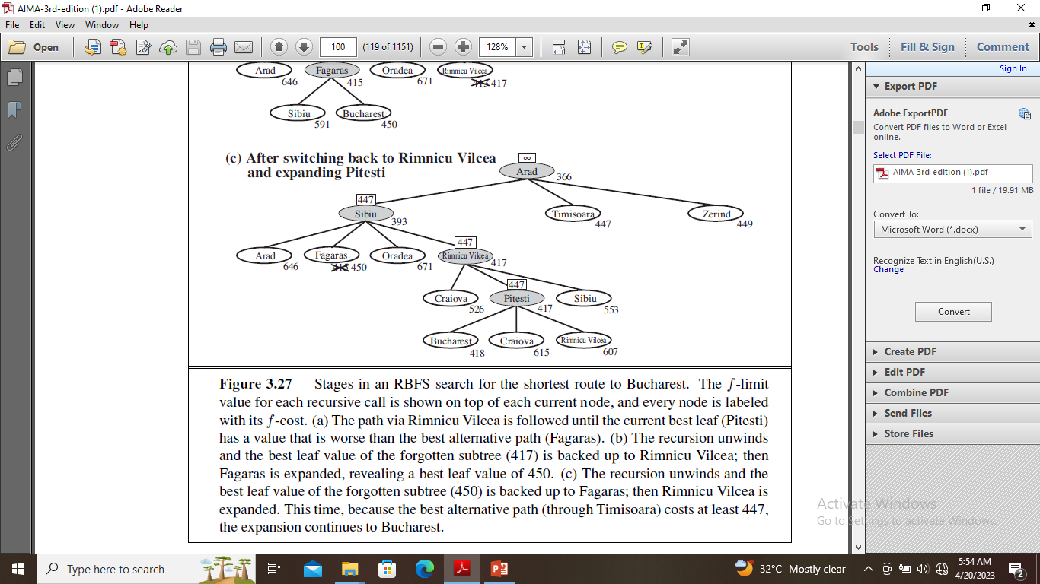
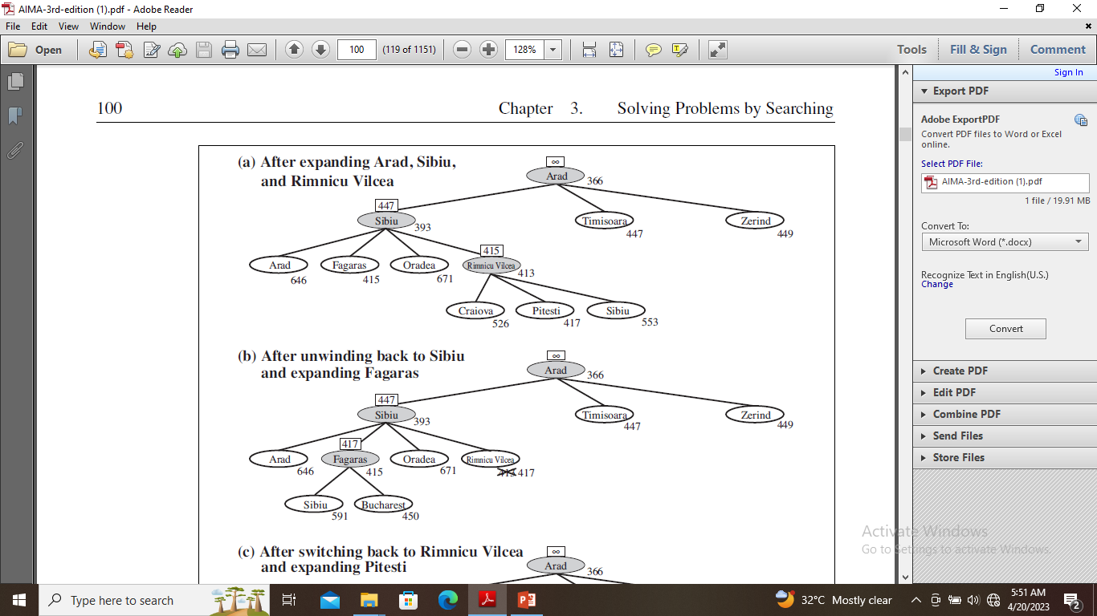

Slide 21
The f-limit value for each recursive call is shown on top of each current node, and every node is labeled with its f-cost.
The path via Rimnicu Vilcea is followed until the current best leaf (Pitesti) has a value that is worse than the best alternative path (Fagaras).
The recursion unwinds and the best leaf value of the forgotten subtree (417) is backed up to Rimnicu Vilcea; then Fagaras is expanded, revealing a best leaf value of 450.
The recursion unwinds and the best leaf value of the forgotten subtree (450) is backed up to Fagaras; then Rimnicu Vilcea is expanded. This time, because the best alternative path (through Timisoara) costs at least 447, the expansion continues to Bucharest.

Slide 22
SMA∗
IDA∗ and RBFS suffer from using too little memory.
Between iterations, IDA∗ retains only a single number: the current f-cost limit.
RBFS retains more information in memory, but it uses only linear space: even if more memory were available, RBFS has no way to make use of it.
Because they forget most of what they have done, both algorithms may end up re-expanding the same states many times over.
It seems sensible, therefore, to use all available memory, two algorithms that do this are MA∗ (memory-bounded A∗) and SMA∗ (simplified MA∗).
SMA∗ proceeds just like A∗, expanding the best leaf until memory is full.
At this point, it cannot add a new node to the search tree without dropping an old one.
SMA∗ always drops the worst leaf node—the one with the highest f-value.
Like RBFS, SMA∗ then backs up the value of the forgotten node to its parent.

Slide 23
What if all the leaf nodes have the same f-value?
To avoid selecting the same node for deletion and expansion, SMA∗ expands the newest best leaf and deletes the oldest worst leaf.
These coincide when there is only one leaf, but in that case, the current search tree must be a single path from root to leaf that fills all of memory.
If the leaf is not a goal node, then even if it is on an optimal solution path, that solution is not reachable with the available memory.
Therefore, the node can be discarded exactly as if it had no successors.
Learning to Search better
Could an agent learn how to search better? The answer is yes, and the method rests on an important concept called the meta-level state space.
Each state in a meta-level state space captures the internal (computational) state of a program that is searching in an object-level state space.
Each action in the meta-level state space is a computation step that alters the internal state(meta-level learning).

Slide 24
1.14 Heuristic Functions
The 8-puzzle was one of the earliest heuristic search problems.
The object of the puzzle is to slide the tiles horizontally or vertically into the empty space until the configuration matches the goal configuration.
When the empty tile is in the middle, four moves are possible; when it is in a corner, two; and when it is along an edge, three.
The branching factor is about 3 .The average solution cost for a randomly generated 8-puzzle instance is about 22 steps.
This means that an exhaustive tree search to depth 22 would look at about 322 ≈ 3.1 × 1010 states.
If we want to find the shortest solutions by using A∗, we need a heuristic function that never overestimates the number of steps to the goal.
There is a long history of such heuristics for the 15-puzzle; here are two commonly used candidates:.h1 and h2.

Slide 25
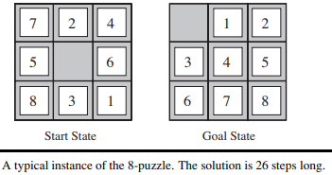
h1 = the number of misplaced tiles., all of the eight tiles are out of position, so the start state would have h1 = 8. (h1 is an admissible heuristic because it is clear that any tile that is out of place must be moved at least once.)
h2 = the sum of the distances of the tiles from their goal positions. (Because tiles cannot move along diagonals, the distance we will count is the sum of the horizontal and vertical distances). h2 is also admissible because all any move can do is move one tile one step MANHATTAN DISTANCE closer to the goal.
Tiles 1 to 8 in the start state give a Manhattan distance
of h2 = 3 + 1 + 2 + 2 + 2 + 3 + 3 + 2 = 18.
As expected, neither of these overestimates the true
solution cost, which is 26.
The quality of a heuristic is based on effective branching
factor b∗.
The effective branching factor is the number of
successors generated by a "typical" node for a given search problem.

Slide 26
Generating admissible heuristics from relaxed problems
If the rules of the puzzle were changed so that a tile could move anywhere instead of just to the adjacent empty square, then h1 would give the exact number of steps in the shortest solution.
Similarly, if a tile could move one square in any direction, even onto an occupied square, then h2 would give the exact number of steps in the shortest solution.
A problem with fewer restrictions on the actions is called a relaxed problem.
For example, if the 8-puzzle actions are described as
tile can move from square A to square B if
A is horizontally or vertically adjacent to B and B is blank,
We can generate three relaxed problems by removing one or both of the conditions:
(a) tile can move from square A to square B if A is adjacent to B.
(b) tile can move from square A to square B if B is blank.
(c) tile can move from square A to square B.

Slide 27
Generating admissible heuristics from sub-problems: Pattern databases
Admissible heuristics can also be derived from the solution cost of a sub-problem of a given problem.
The sub-problem involves getting tiles 1, 2, 3, 4 into their correct positions.
Clearly, the cost of the optimal solution of this sub-problem is a lower bound on the cost of the complete problem.
It turns out to be more accurate than Manhattan distance in some cases.
The idea behind pattern databases is to store these exact solution costs for every possible sub-problem instance—in our example, every possible configuration of the four tiles and the blank.
The heuristics obtained from the 1-2-3-4 database and the 5-6-7-8 could be added, since the two sub-problems seem not to overlap.

Slide 28
